Slide 1
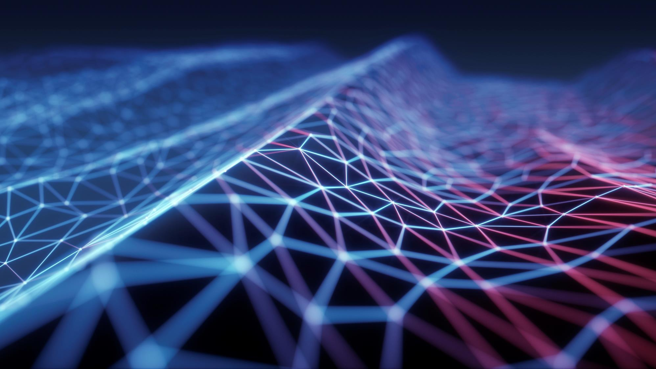
Researches on Graphs

Slide 2
Summary POSSIBLE RESEARCH AREAS
Alternative Encodings for Graph Structures, There are several new researches for defining node positions in the graph using Transformer , Attentions and Spectral Approaches.
For developing Graphs, computattionl complexity is another challende, Efficient Grpah Trasformers can provide better approaches in Slide 1 – Graph Encoding
Temporal information or Timing is stil not widely studied field yet in Graph Structures in Slide 2 – Time In Messages
In Slides 5,6,7,8,9 GRAPH NEURAL NETWORKS WITH LEARNABLE STRUCTURAL AND POSITIONAL REPRESENTATIONS Researches details about for new approaches in Structural and Positional Encoding Graph Nodes .
Scene Graph Generation is a long-time research area for defining Scene in computer vision tasks Object Detection, Action Recognition, Predictions etc tasks. Also it can be used for defning Grpah Structual information for images and videos. For robotics tasks like Human-computer interation or Autonomous tasks Scene Grpah Generation can be used. In Slides 10-11-12 possible oppurtunites and problems are defined in «Scene Graph Generation: A comprehensive survey»
In Slide 13,14 for Scene Graph Generation a new approach as Panoptic Scene Graph Generation is provided which has alternative to bounding boxes used in very popular approac in Scene Graph Generation. As an alernatives to both approaches Image Segmnated Views can be considered to define the Object Detections problems in Scene Grpah Generation

Slide 3
Summary POSSIBLE RESEARCH AREAS
In Slide 15 A research work Image Segmentation using Graph Structure on «Spectral Image Segmentation with Global Appearance Modeling» is provided. In this works, the Graph encodng is provided using Global information in Image. While generating graphs, Global Position information can provide a better information for individual node representations. This segmentation wrok can be enhanced with the Graph Structural and Positional Encoding wtih the previous works to generate, Scene Grpah Genations with Segmented Views as alternative for using Bounding Box Object descriptors.
In slide 16 «Deep Reinforcement Learning for Vision-Based Navigation of UAVs in Avoiding Stationary and Mobile Obstacles» is a researh work for Autonmous Moving for UAVS which uses Motions Planner with suuport of recongizing environments for Avoiding Stationary and Obstacles. A Genetated Scene Graph Struture based Autonomous Driving – Moving can be challenging for future researches.
In Slide 17, 18 «Manipulation Action Recognition and Reconstruction using a Deep Scene Graph Network», «SCENE GRAPH GENERATION - A Variational Graph Autoencoder for Manipulation Action Recognition and Prediction» provides a reseach on Action Recognition and Reconstruction for moving robotic tasks using Deep Scene Grpah Network using Encoder and Decoder Graph Generating approach with the support of predefined image masks defining environment. This work can be enhanced with alternatives to Handcrafted Masks in supervised data.
In Slide 19 «Complex Video Action Reasoning via Learnable Markov Logic Network» using message passing mechasim in global visual context for predicting scene graph, it has been applied to the video domain for spatio-temporal scene graph for respreenting semantic information of a complex action
In Slide 20 , There is another approach of using Graph Representation Learning on Relational Databases for General Classification, Prediction, Segmentaion tasks on data stored in Relational Databases. It provides Graph structured Schemas generated for AI tasks for Data Preprocessing»

Slide 4
GRAPH NEURAL NETWORKS POSSIBLE RESEARCH AREAS - Graph Transformers – GrAPH STRUCTURES
1️⃣ Expressiveness of GTs. As mentioned in the GNN Theory section, recent work from Cai et al. (2023) shows the equivalence between MPNNs with a Virtural Node and GTs under a non-uniform setting. This poses a question on how powerful are GTs and what is the source of their representation ability. Zhang et al. (2023) successfully combine a new powerful positional embedding (PE) to improve the expressiveness of their GTs, achieving expressivity over the biconnectivity problem. This gives evidence of the importance of PEs to the expressiveness of GTs. A recent submission GPNN provides a clearer view on the central role of the positional encoding. It has been shown that one can generalize the proof in Zhang et al. (2023) to show how GTs’ expressiveness is decided by various positional encodings.
2️⃣ Positional (Structural) Encoding. Given the importance of PE/SE to GTs, now we turn to the design of those expressive features usually derived from existing graph invariants. In 2022, GraphGPS observed a huge empirical success by combining GTs with various (or even multiple) PE/SEs. In 2023, more powerful PE/SE is available.
The design of expressive features in GTs, typically derived from existing graph invariants, has seen advancements. GraphGPS (2022) combined GTs with various PE/SEs, demonstrating significant empirical success. In 2023, Ma et al. proposed Relative Random Walk PE (RRWP), a more powerful positional encoding, achieving strong empirical performance on property prediction benchmarks. Puny et al. proposed a theoretical framework for improving the expressivity of common Graph Neural Networks (GNNs) using equivariant polynomials as positional encodings, yielding surprising empirical results.
3️⃣ Efficient GTs. It remains challenging for GTs to be applied to large graphs due to the O(N²) complexity. In 2023, we saw more works trying to eliminate such difficulty by lowering the computation complexity of GTs. Deac et al used expander graphs for the propagation, which is regularly connected with few edges. Exphormer extended this idea to GT by combining expander graphs with the local neighborhood aggregation and virtual node. Exphormer allows graph transformers to scale to larger graphs (as large as ogbn-arxiv with 169K nodes). It also achieved strong empirical results and ranked top on several Long-Range Graph Benchmark tasks.
A better understanding of self-attention’s benefits on abstract beyond expressiveness.
More powerful positional encodings.

Slide 5
GRAPH NEURAL NETWORKS POSSIBLE RESEARCH AREAS – TIme IN MESSAGES
This article discusses recent advancements in Graph Neural Networks (GNNs) that incorporate the concept of time into message passing.
Traditionally, GNNs have assumed a static message passing approach. This means information propagates between nodes in a fixed order.
Recent research suggests that considering time can improve GNN performance. There are two main approaches:
Dynamic message scheduling: This allows nodes to control when they send or receive messages. Co-GNNs are an example that enables nodes to choose broadcast, listen, or isolate states.
Graph rewiring: This involves altering the connections between nodes over time. DREW is an example that adds connections between nodes at increasing distances as layers progress. This injects a form of artificial time dependence even for static graphs.
Benefits of incorporating time:
More flexible information flow: Nodes can determine how they communicate with neighbors.
Reduced oversmoothing: Messages traveling long distances can have a less smoothing effect.
Improved performance on deeper GNNs: Techniques like DREW can address challenges with deep GNNs.
Future directions:
Understanding the impact of time rewiring: More research is needed to understand why rewiring over time benefits GNN training.
Applying time-based GNNs to scientific domains: This could be useful for 3D problems with temporal properties.
Overall, incorporating time into GNNs is a promising area of research with the potential to significantly improve performance

Slide 6
GRAPH NEURAL NETWORKS WITH LEARNABLE STRUCTURAL AND POSITIONAL REPRESENTATIONS
Possible Oppurtunity for: Scene Graph Generation with a new approach SegmentedView Graph Positional Encoding for detected object or instances on the images, frames
The concept of positional encoding, which involves assigning global positions to elements such as pixels in images, words in texts, or nodes in graphs, is crucial for the effectiveness of various neural network architectures like Convolutional Neural Networks (ConvNets), Recurrent Neural Networks (RNNs), Transformers, and Graph Neural Networks (GNNs). These architectures utilize structural and positional information to create abstract feature representations of data.
In ConvNets, spatial structure is inherently considered for pixel positions, while RNNs utilize the sequential structure of word positions, and Transformers incorporate positional encoding for words. However, for GNNs, determining the positions of nodes in graphs is more complex due to the absence of a standard positioning system for nodes in arbitrary graphs. This lack of a global and relative position concept in graphs poses challenges as there are no predefined directions like top, down, left, and right as in images.
Despite these challenges, positional encoding remains critical for GNNs in the same way as it is for ConvNets, RNNs, and Transformers. This importance has been demonstrated through its impact on prediction tasks involving graphs.

Slide 7
GRAPH NEURAL NETWORKS WITH LEARNABLE STRUCTURAL AND POSITIONAL REPRESENTATIONS
Laplacian Positional Encoding is a method proposed for graph representation that aims to provide a unique representation for each node while being permutation-invariant and distance-sensitive. This means that the difference between the positional encodings (PEs) of two nodes far apart in the graph should be large, while it should be small for two nearby nodes.
The approach utilizes Laplacian eigenvectors, which are derived from the factorization of the graph Laplacian matrix. Laplacian eigenvectors belong to the class of unsupervised manifold learning techniques and are spectral techniques that embed graphs into Euclidean spaces. The Laplacian matrix is factorized as the product of matrices representing eigenvalues and eigenvectors, preserving both local and global graph structure.
These eigenvectors possess properties such as permutation-invariance, uniqueness, computational efficiency, and sensitivity to distances within the graph topology. As a result, they are considered suitable for graph positional encoding. Laplacian eigenvectors also offer a natural extension of positional encoding used in Transformer models to arbitrary graphs.

Slide 8
GRAPH NEURAL NETWORKS WITH LEARNABLE STRUCTURAL AND POSITIONAL REPRESENTATIONS
Several other approaches for graph positional encoding (PE) have been proposed:
Distance Encoding (DE): Li et al. (2020b) introduced DE as node attributes and controllers of message aggregation. DE captures relative distances between nodes in a graph using powers of the random walk matrix, showing improved expressivity over the 1-WL test. However, its effectiveness may be limited on regular graphs, and the computational cost and memory requirements of using power matrices may hinder its application to larger graphs.
Random Walk with Restart (RWR): Khasahmadi et al. (2020) utilized RWR as topological embeddings with initial node features, providing a way to capture graph structure effectively.
Learnable Position-Aware Embeddings: You et al. (2019) proposed learnable position-aware embeddings based on random anchor sets of nodes for pairwise node tasks. However, the random selection of anchors may limit the generalizability of this approach for inductive tasks.
Hybrid GNNs based on WL-test and Message Passing: Bouritsas et al. (2020); Bodnar et al. (2021) introduced hybrid GNNs that incorporate prior knowledge about specific classes of graphs, such as rings for molecules and cliques for social networks. This prior information is encoded into Message Passing GNNs to enhance model expressiveness. These models achieve top performance on molecular datasets, but pre-computation of graph sub-structures and the complexity of sub-graph matching and counting may be challenging. However, incorporating information about substructure counting, such as the number of rings associated with an atom, can significantly enhance higher-order structural information and improve related tasks.

Slide 9
GRAPH NEURAL NETWORKS WITH LEARNABLE STRUCTURAL AND POSITIONAL REPRESENTATIONS
Recently developed Transformer-based models such as Spectral Attention Networks (SAN) by Kreuzer et al. (2021), GraphiT by Mialon et al. (2021), and Graphormer by Ying et al. (2021) exhibit promise in operating on full graphs, incorporating various techniques for encoding both positional and structural features within the network.
Spectral Attention Networks (SAN) operate on full graphs, distinguishing between parameters from existing and non-existing edges in the graph. Attentions from both types of edges are weighted by a tunable scalar γ, offering flexibility across different tasks. SAN also integrates a Learnable Positional Encoding (LPE) module, which transforms Laplacian eigenvectors into a fixed-size positional encoding using a self-attention encoder.
Similarly, GraphiT is a full-graph Transformer Graph Neural Network (GNN) leveraging diffusion distance to capture interactions between nodes based on graph topology. This pairwise diffusion distance serves as a multiplicative weight, adapting weight scores based on node proximity. For instance, closer nodes have higher diffusion distance values, while nodes further apart have lower values.

Slide 10
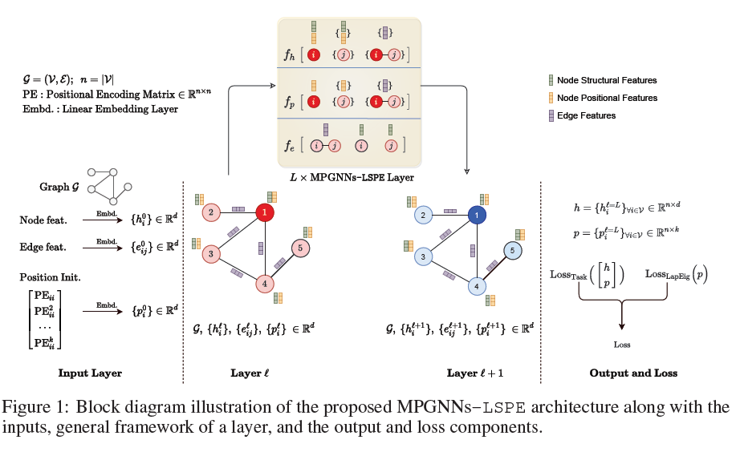
GRAPH NEURAL NETWORKS WITH LEARNABLE STRUCTURAL AND POSITIONAL REPRESENTATIONS
Proposed structure decouple structural and positional representations to make easy for the network to learn these two essential properties. LSPE (Learnable Structural and Positional Encodings).
We investigate several sparse and fully-connected (Transformer-like) GNNs, and observe a performance increase for datasets when considering learnable PE for both GNN classes.
Learning positional representation that can be combined with structural GNNs to generate more expressive node embedding

Slide 11
Scene Graph Generation: A comprehensive survey
Several challenges persist in Scene Graph Generation (SGG) despite the advancements made by excellent models on standard image datasets
Efficiency in Relationship Detection: The vast number of objects and relationship categories in the real world make exhaustive detection and classification of all object pairs inefficient. Efforts have been made to filter out unlikely object pairs, enhancing efficiency and reducing computational costs.
Long-Tailed Distribution: Visual relationships often exhibit a long-tailed distribution, with rare relationships being underrepresented in datasets. Biased Scene Graph Generation occurs when models favor predicting common relationships over rare ones, leading to coarse and inadequate scene descriptions. Unbiased SGG aims to address this imbalance, giving more attention to tail classes.
Variability in Visual Appearance: The visual appearance of the same relationship can vary significantly across different scenes, posing challenges for feature extraction. While many methods focus on semantic features, extracting discriminative visual features is crucial for accurately capturing scene-specific relationships.
Ambiguity in Relationship Definitions: Defining relationships is inherently challenging, as opposed to objects with clear meanings. Different predicates can describe the same relationship, leading to noisy datasets and an ill-posed SGG task. Establishing a well-defined relationship set remains a key challenge.
Evaluation Metrics: Existing evaluation metrics like Recall@K provide relative performance measures, but they may not fully capture the model's capability in generating accurate scene graphs. The lack of perfect evaluation metrics poses a challenge as the field progresses, necessitating the development of more robust benchmarks.

Slide 12
Scene Graph Generation: A comprehensive survey
The research discusses the importance of global message passing and analyzes various methods for message passing in scene graph generation (SGG):
Global Message Passing Across All Elements: Objects with visual relationships are semantically related, and passing messages between related elements can enhance scene-specific visual relationship detection. Message passing on graph or subgraph structures and using chain-based models or dynamic tree structures are natural choices.
Message Passing on Graph Structures: Techniques like Multi-level Scene Description Network (MSDN) and Factorizable Network (F-Net) employ message passing guided by dynamic graphs constructed from objects and caption region proposals. Context-based methods like Context-based Captioning and Scene Graph Generation Network (C2SGNet) consider unidirectional message passing between phrase and region proposals. Approximations like mean field in Conditional Random Fields (CRF) and CRF or RNN formulations are used for densely connected graph inference.
Message Passing on Tree Structures: Dynamic tree structures like VCTREE encode visual contexts efficiently, offering advantages over oversimplified chain structures or complete but non-hierarchical graphs. VCTREE construction involves learning a score matrix, obtaining a maximum spanning tree, and converting it into an equivalent binary tree using TreeLSTM for context encoding and decoding.
Overall, the passage highlights the significance of joint reasoning with contextual information and explores various approaches to message passing in SGG, including graph and tree structures.

Slide 13
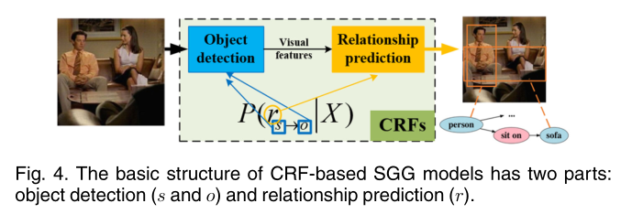
A Comprehensive Survey of Scene Graphs: Generation and Application
Scene graph is a structured representation of a scene that can clearly express the objects, attributes, and relationships between objects in the scene. As computer vision technology continues to develop, people are no longer satisfied with simply detecting and recognizing objects in images; instead, people look forward to a higher level of understanding and reasoning about visual scenes.
A scene graph is a topological representation of a scene, the primary goal of which is to encode objects and their relationships. Moreover, the key challenge task is to detect/recognize the relationships between the objects. Currently, the SGG methods can be roughly divided into CRF-based SGG, TransE-based SGG, CNN-based SGG, RNN/LSTM-based SGG, and GNN-based SGG. In this section, we conduct a detailed review of each category of these methods.

Slide 14
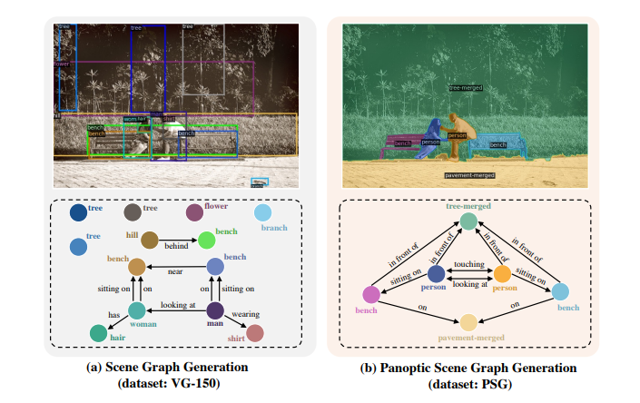
Panoptic Scene Graph Generation
Traditional approach to Scene Graph Generation (SGG), which relies on bounding boxes for object detection and pairwise relationship prediction. Several drawbacks of this approach:
Coarse Localization: Bounding boxes provide only a coarse localization of objects, often containing noisy or ambiguous pixels from different objects or categories.
Limited Scene Coverage: Bounding boxes typically do not cover the entire scene of an image, ignoring crucial contextual information.
Redundant Information: Current SGG datasets often include redundant classes and information, which may be deemed trivial or confusing for the model.
Inconsistent Labels: Inconsistent and redundant labels are observed in current datasets, leading to confusion during model training.
To address these issues, the research suggests using panoptic segmentation labels instead of bounding boxes for constructing scene graphs. It introduces the concept of Panoptic Scene Graph Generation (PSG), aiming to generate scene graph representations based on panoptic segmentations, which offer clearer and more precise grounding of objects and comprehensive scene understanding.

Slide 15
Panoptic Scene Graph Generation
The research discusses challenges and outlooks for Panoptic Scene Graph Generation (PSG) tasks:
Effective Use of Priors: While prior knowledge introduced by two-stage SGG methods may not be effective for PSG tasks, more creative knowledge-aided models are expected to be developed in the era of multimodality to extract interesting triplets with additional priors. However, PSG predictions should heavily rely on visual clues despite the use of priors.
Prediction of Meaningful Relations: PSG models should aim to predict more meaningful and diverse relations, including rare relations like feeding and kissing, rather than focusing solely on statistically common or positional relations.
Relation with Panoptic Segmentation: The passage discusses the visualization of panoptic segmentation results by PSG methods. It highlights challenges in PSGTR where triplet queries may produce object groundings independently, leading to difficulties in deduplication or re-identification. While the performance of re-identification does not directly affect PSG metrics, it is crucial for forming accurate and logical scene understanding for real-world applications.
Future Outlook: In addition to encouraging more research on learning relations and advancing scene understanding, PSG models are expected to enable exciting downstream tasks such as visual reasoning and segmentation-based scene graph-to-image generation.

Slide 16
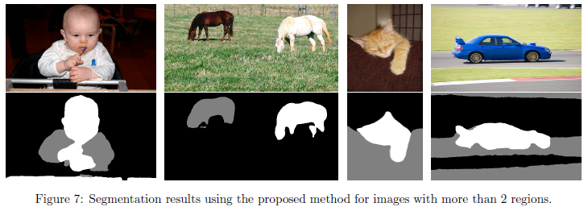
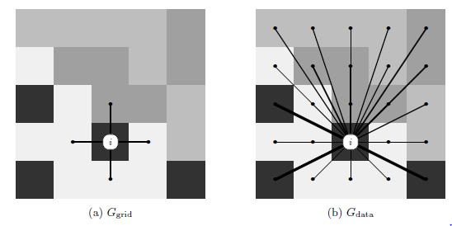
Spectral Image Segmentation with Global Appearance Modeling
The research discusses the foundation and challenges of spectral graph partitioning, particularly in the context of image segmentation.
It highlights the seminal work of Shi and Malik on normalized cuts for image segmentation and subsequent developments in spectral clustering and image segmentation. Challenges include efficiently constructing a graph over pixels and performing spectral decomposition. Traditional approaches use sparse graphs and approximate eigenvector solvers, but the proposed method starts with a dense graph and utilizes edge sparsification based on importance sampling.
The method emphasizes the use of raw pixel intensities for computing pixel affinities and demonstrates superior performance in segmenting textured images compared to traditional methods.
The text also discusses the relationship between spectral segmentation algorithms and multiview clustering methods, which aim to cluster data using different features or views. While existing multiview clustering methods have not been applied to image segmentation due to computational burdens, the proposed method does not require training data and produces interpretable results. Additionally, it emphasizes the utilization of long-range relationships between pixels, which are not explicitly present in typical deep learning frameworks commonly used for image segmentation.
We break the grouping cues (spatial proximity and appearance similarity) into two separate graphs, Ggrid and Gdata. Both graphs are defined over the same set of vertices, corresponding to the pixels in an image.
1. The graph Ggrid is a grid over the image pixels, where each pixel is connected to the four neighboring
pixels with an edge of weight 1. This graph encourages neighboring pixels to be grouped together,
independent of their appearance.
2. The graph Gdata is a fully connected graph that encourages pixels with similar appearance to be grouped
together, independent of their location. The weights in Gdata are based on appearance similarity of
pixels, and do not depend on pixel locations,

Slide 17
Deep Reinforcement Learning for Vision-Based Navigation of UAVs in Avoiding Stationary and Mobile Obstacles
Autonomous systems, which can perform tasks without human intervention, are increasingly used to reduce errors and enhance operational efficiency. Autonomous drones offer immediate situational awareness and response capabilities in emergencies, without requiring a pilot on-site, making them valuable for security, inspection, and other applications.
Initially, researchers focused on self-navigation drones using GPS coordinates to reach predefined destinations. However, collision avoidance remains a challenge, as drones can collide with obstacles despite GPS navigation.
Researchers have employed various approaches for collision avoidance, including visual sensors, laser range finders, and ultrasonic sensors. Visual sensors are preferred for small or medium-sized UAVs due to their compactness, lightweight, and energy efficiency, as well as their ability to provide rich environmental information.
Vision-based navigation systems employ strategies such as geometric relations, fuzzy logic, potential fields, and neural networks for obstacle detection and avoidance. In recent years, deep reinforcement learning (DRL) has emerged as a promising approach for obstacle avoidance in drones. RL-based techniques allow drones to adapt dynamically to the environment by learning in a virtual setting and then applying the trained model to real drones for testing. Close alignment between the training environment and the real world is crucial for effective RL-based collision avoidance, with various obstacle scenarios considered during training. Choosing the appropriate RL model is essential for achieving optimal results.
In future research, the effectiveness of the collision avoidance algorithms could be improved by training them in more environments that mimic the real world. The research could be extended to creating a path-following model, which would be incorporated into the current model. It would also be worthwhile to assess the hardware power consumption and other related factors, as well as its efficiency in real-life situations by incorporating it into a real drone and analyzing how it avoids obstacles

Slide 18
Manipulation Action Recognition and Reconstruction using a Deep Scene Graph Network
Imitation learning has seen consistent growth across various research areas, including human-robot interaction, machine learning, and machine vision, driven by the demand for intelligent applications.
While manipulation action recognition has been widely studied, the use of graph-based deep neural networks in this domain remains uncommon.
The proposed approach utilizes graph networks (GN) to classify object-action relations, considering both spatial and temporal relations. Spatial relations refer to interactions between objects in a single frame (e.g., hand touching a bowl), while temporal relations involve relationships between objects across consecutive frames, capturing changes over time.
Additionally, the network includes a branch for graph reconstruction, laying the groundwork for further development.
Key aspects of novelty in this research include:
Developing a modular perception pipeline grounded in continuous signal data.
Implementing a deep graph network for manipulation action recognition and graph reconstruction tasks.
Providing a framework for real-time demonstration and testing with novel subjects using images derived from the perception pipeline. The proposed system will be evaluated against two different baselines on separate datasets to assess its performance in the relatively narrow field of graph-based manipulation action recognition.
The thesis focuses on classifying human manipulation actions using a Graph Network (GN) classifier and explores graph reconstruction from a latent space representation, with the potential for future graph prediction. The input for the network is a scene graph generated through a preprocessing pipeline that takes RGB images as input and outputs a scene graph. In the scene graph, nodes represent detected objects, and edges indicate spatial relationships between pairs of objects. Additionally, the thesis aims to analyze the temporal relation between consecutive scene graphs and compare the proposed solution with previous methods for manipulation action recognition.

Slide 19
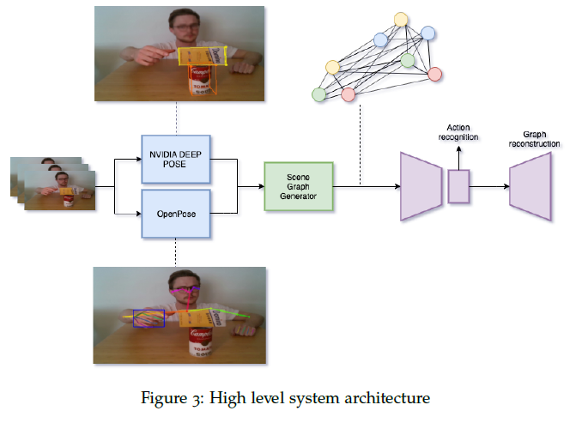
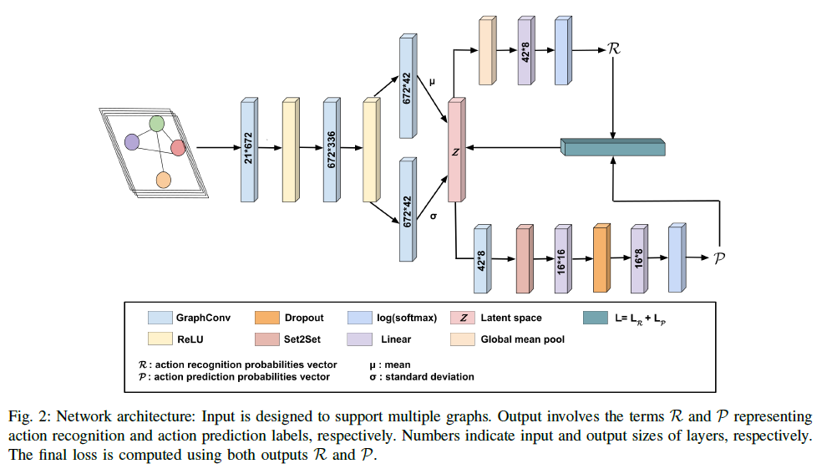
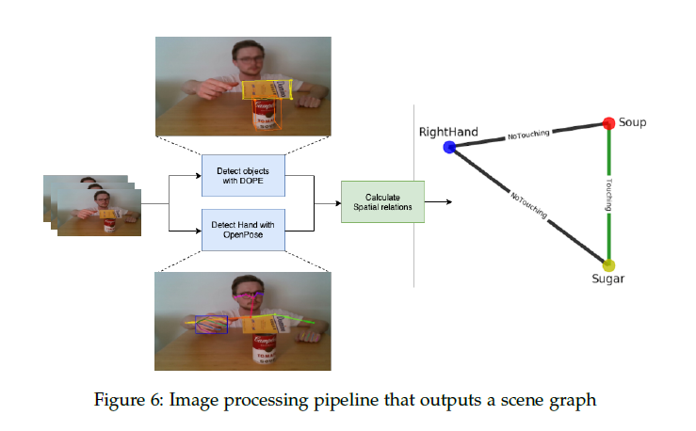
SCENE GRAPH GENERATION - A Variational Graph Autoencoder for Manipulation Action Recognition and Prediction
Different from the related works, we here introduce a deep graph autoencoder to jointly learn recognition and prediction of manipulation tasks from symbolic scene graphs, instead of relying on the structured Euclidean data.
Our network has a variational autoencoder structure with two branches: one for identifying the input graph type and one for predicting the future graphs. The input of the proposed network is a set of semantic graphs which store the spatial relations between subjects and objects in the scene. The network output is a label set representing the detected and predicted class types..

Slide 20
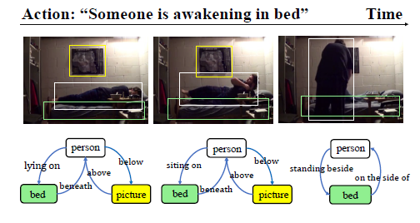
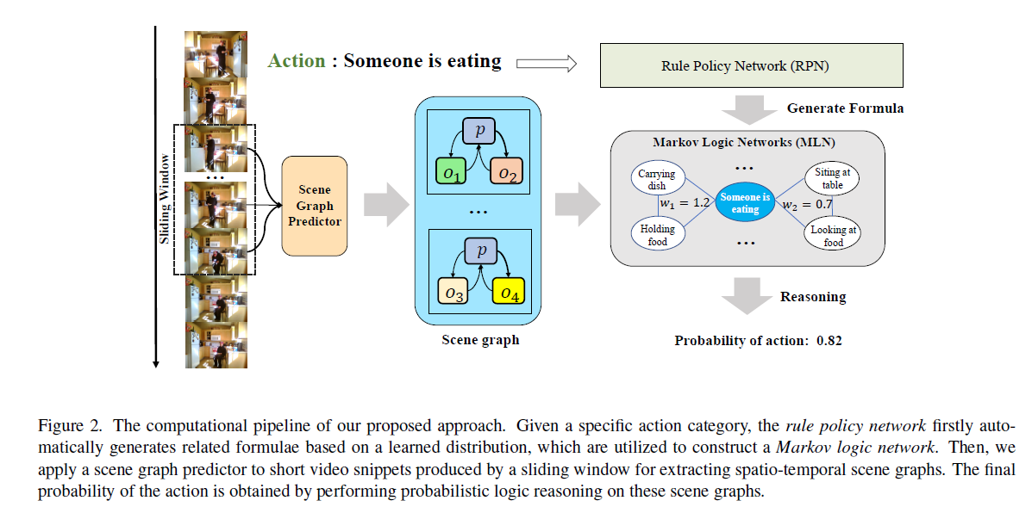
Complex Video Action Reasoning via Learnable Markov Logic Network
Scene graph generation. Scene graph is a structural representation for understanding visual content in static images, where each unique object defines a node, and the relationship between two objects corresponds to an edge.
Owning to the potential of enhancing many down-stream visual reasoning tasks, this task has attracted tremendous attention from researchers. By harnessing the message passing mechanism, recent methods are capable of fully exploiting the global visual context and predicting satisfactory scene graphs. In this work, we apply it to the video domain and generate a spatio-temporal scene graph in video segments to represent the semantic information
of a complex action.

Slide 21
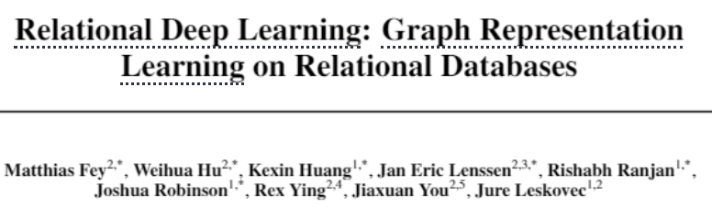
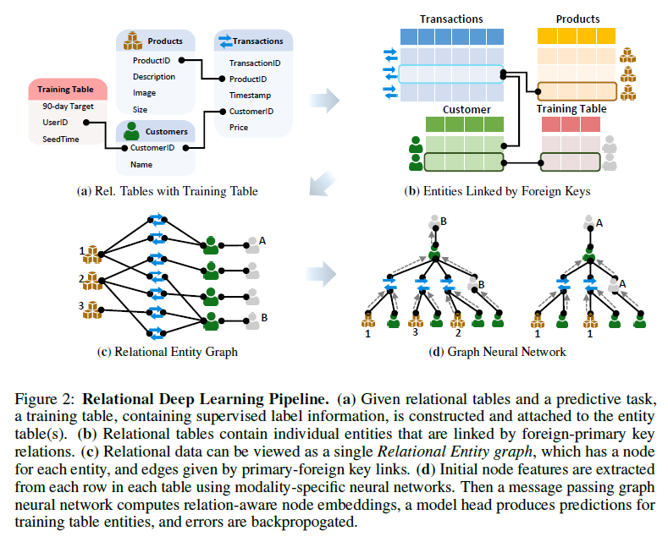
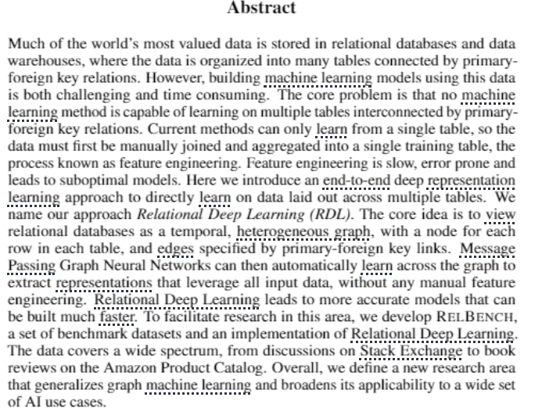
Relatıonal Deep LEARNING

Slide 23

Thank You

